Slide 1
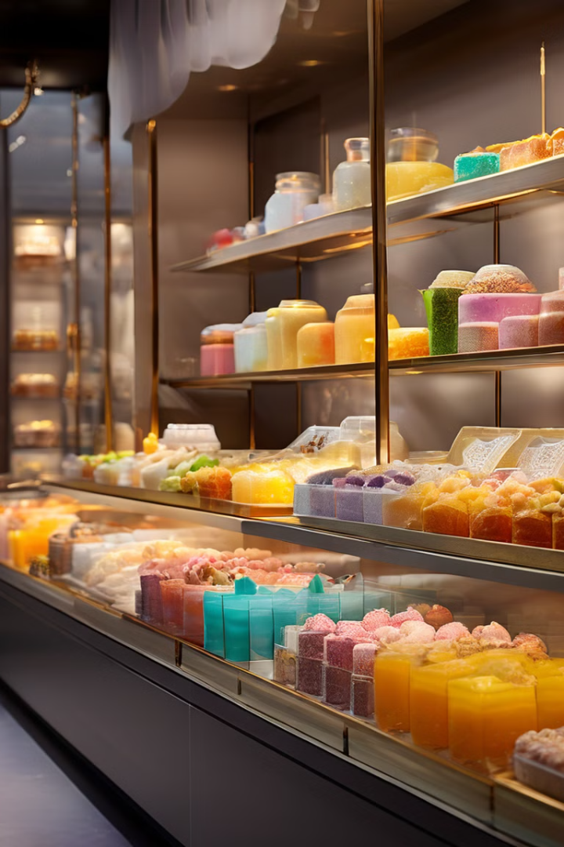
DessertDeck: Online Sweet Shop
DessertDeck is a user-friendly web application designed to bring a traditional sweet shop into the digital age.
Group Members :-
1) Omkar Arjun Kamble :- 236358.
2) Aniket Rajendra Kale :- 236306.

Slide 2
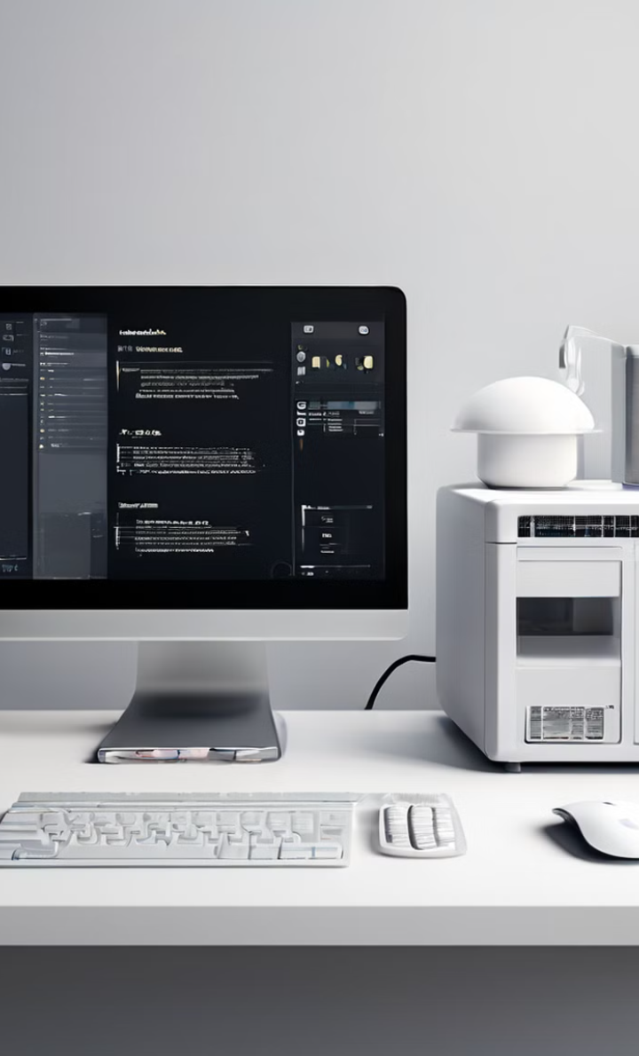




Technical Requirements
DessertDeck requires a minimum set of hardware and software specifications to ensure smooth operation and optimal performance.
Processor
I5 or Above
RAM
1GB or Above
Hard Disk
256GB or Above
Operating System
Up to Windows 11

Slide 3
LANGUAGE USED
HTML (HYPERTEXT MARKUP LANGUAGE)
CSS (CASCADING STYLE SHEET)
BOOTSTRAP (FRAMEWORK OF CSS AND JS)
PYTHON
DJANGO
SQLITE (DATABASE)

Slide 4
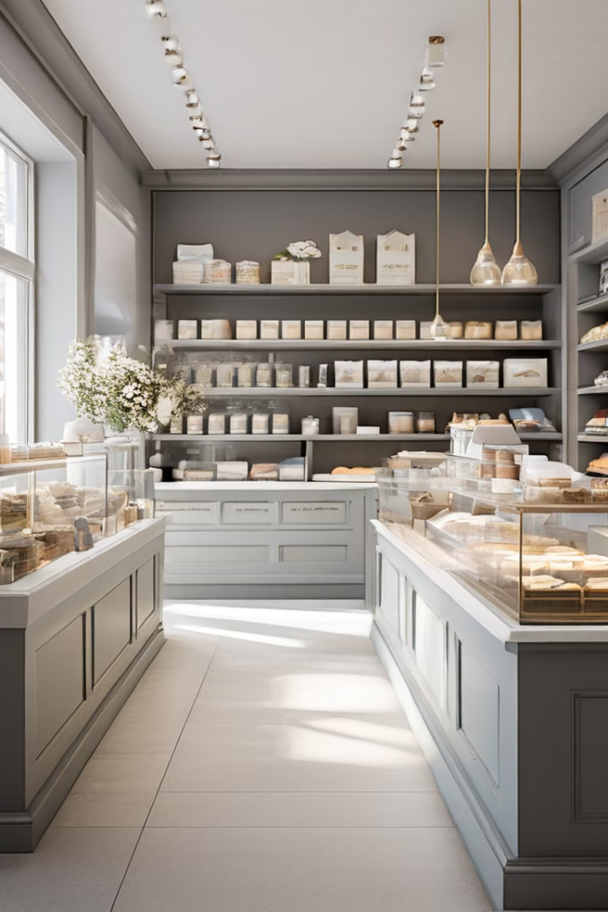
Problem Statement
The Sweet Shop, a traditional business specializing in a variety of sweets, is facing challenges due to the growing trend of online shopping.
Inefficient Systems
The current manual or basic digital systems are inefficient and limit the shop's ability to expand and manage operations effectively.
Limited Reach
There is a need for a comprehensive web-based platform to handle online sales and streamline business processes.

Slide 5

Objectives
DessertDeck aims to address the challenges faced by traditional sweet shops by providing a comprehensive online platform.
1
Expand Business Reach
2
Enhance Operational Efficiency
3
Improve Customer Experience
Develop an online platform to reach a broader audience beyond the local community.
Implement automation to streamline inventory management, order processing, and customer interactions.
Provide a convenient and user-friendly shopping experience for customers.

Slide 6
Features
DessertDeck offers a range of features to cater to both customers and administrators.
Customer Features
Admin Features
Create accounts, log in, and recover passwords
Manage the product catalog
Explore a catalog of sweets with names, descriptions, prices, and images
Oversee orders and handle user accounts
Search and filter products
Add, update, or remove items from their shopping cart
Place orders, receive confirmations, and track order status
Update personal information and view order history

Slide 7

Existing System
Many sweet shops rely on manual processes or basic digital tools, which can lead to inefficiencies and errors.
1
Manual Processes
Manual inventory tracking, order taking, and customer interactions are prone to errors and delays.
2
Basic Digital Tools
Outdated systems lack the automation and integration needed for modern business operations.
3
Limited Functionality
These systems lack the features and capabilities required for online sales and customer management.

Slide 8

Feasibility Study Points
Technical Feasibility: The DessertDeck project requires a minimum hardware setup of an i5 processor, 1GB RAM, and 256GB hard disk. It is compatible with any hosting service and is designed to operate on Windows 11 using Python Django with an SQLite database, ensuring it can be implemented with available resources.
Operational Feasibility: The project aims to streamline traditional sweet shop operations by automating inventory management, order processing, and customer interaction, which will significantly enhance operational efficiency and customer satisfaction.
Economic Feasibility: Investing in the DessertDeck platform can potentially increase revenue by expanding the customer base beyond the local community through online sales, justifying the initial development costs.
Legal Feasibility: The project must comply with e-commerce regulations, data protection laws, and consumer rights to ensure smooth operation without legal hindrances.

Slide 9
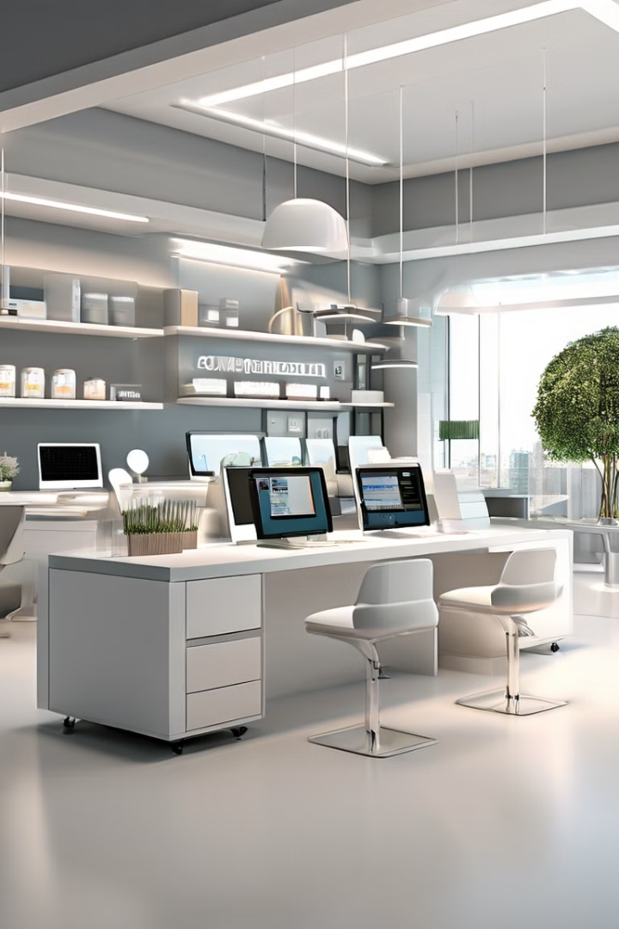



Need for Computerization
Automating the DessertDeck offers several benefits, including real-time inventory tracking, accurate record-keeping, automated accounting, and online ordering capabilities.
Enhanced Efficiency
Streamlined operations, reduced errors, and improved productivity.
Improved Financial Management
Accurate accounting, real-time financial data, and better decision-making.
Increased Customer Satisfaction
Convenient online ordering, faster order processing, and personalized experiences.

Slide 10
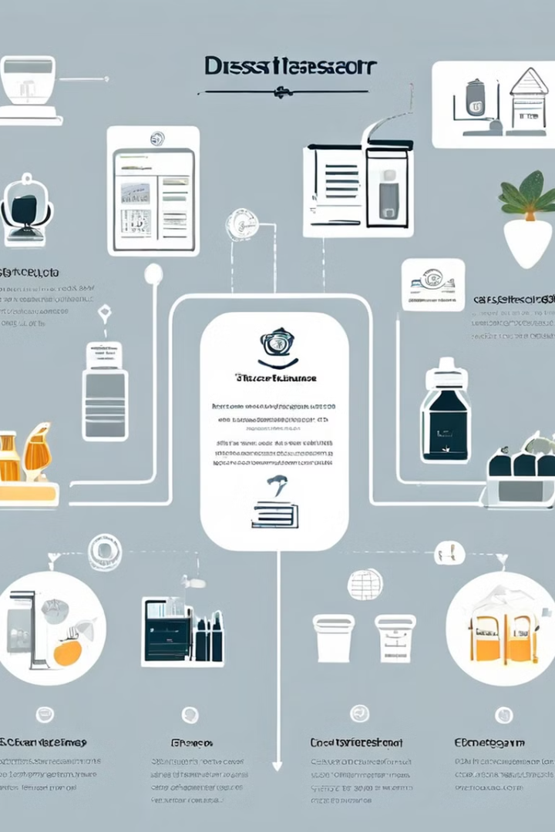
Scope of the Proposed System
The proposed system will cover areas such as inventory management, sales and billing, customer relationship management (CRM), order management, financial management, and user experience.
Inventory Management
Real-time tracking, stock alerts, and automated ordering.
Sales and Billing
Online ordering, secure payment processing, and automated invoicing.
Customer Relationship Management (CRM)
Customer profiles, order history, and personalized communication.
Order Management
Order tracking, status updates, and delivery management.
Financial Management
Automated accounting, financial reporting, and profit analysis.
User Experience
Intuitive interface, easy navigation, and mobile responsiveness.

Slide 11
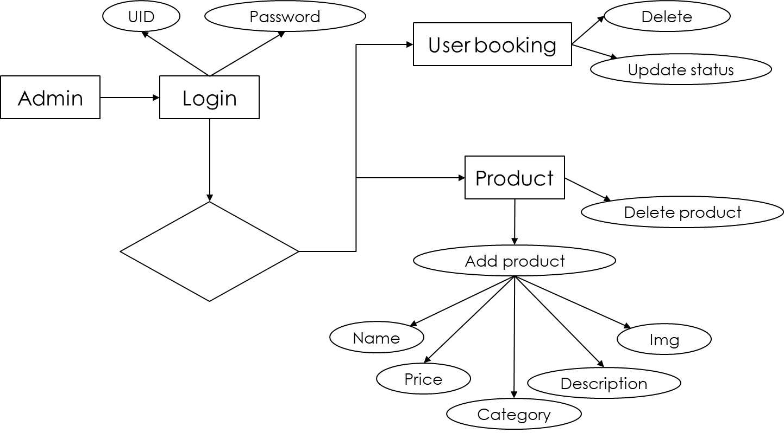
ER DIAGRAM(Admin)

Slide 12
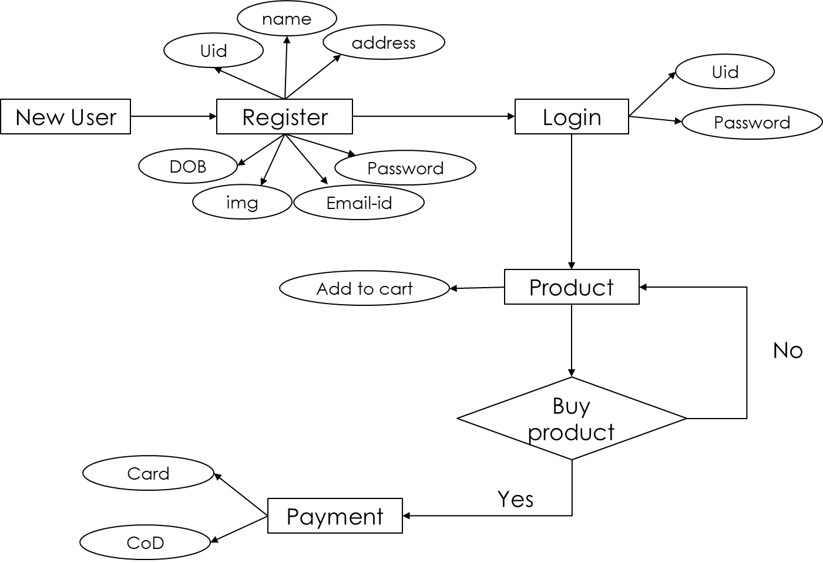
ER DIAGRAM(User)

Slide 13
USE CASE DIAGRAM(Admin)
Manage Products
Manage
Users
Manage Booking
System
Manage Feedback

Slide 14
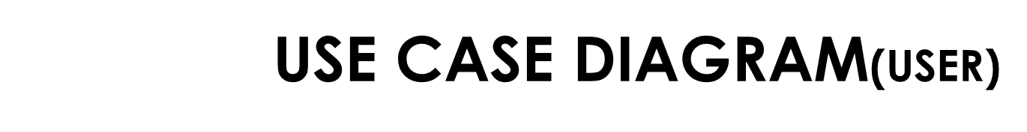
Booking
Cancel Booking
Search Sweet
Feedback
USER
Edit Profile
SYSTEM

Slide 15
Functional Decomposition
User Account Management: The system will allow customers to create and manage their accounts, including features for logging in, password recovery, and updating personal information.
Product Catalog Management: A central feature where the system displays a comprehensive list of available sweets, allowing users to search, filter, and view detailed product descriptions, prices, and images.
Shopping Cart and Order Processing: This function handles the shopping cart where users can add, update, or remove items, proceed to checkout, and manage the order process, including receiving order confirmations and tracking status.
Admin Panel Management: Admins will have access to tools for managing the product catalog, overseeing orders, handling user accounts, and maintaining overall system operations to ensure smooth functioning.
Inventory and Sales Management: The system will automate the tracking of inventory levels, update stock in real-time, and manage sales data to streamline the business's supply chain and financial processes.

